Slide 1



DBMS Assignment 1
Design and Implementation of a database management system for Research Project, Publication and Grant Management System
Presentation 2

Slide 2
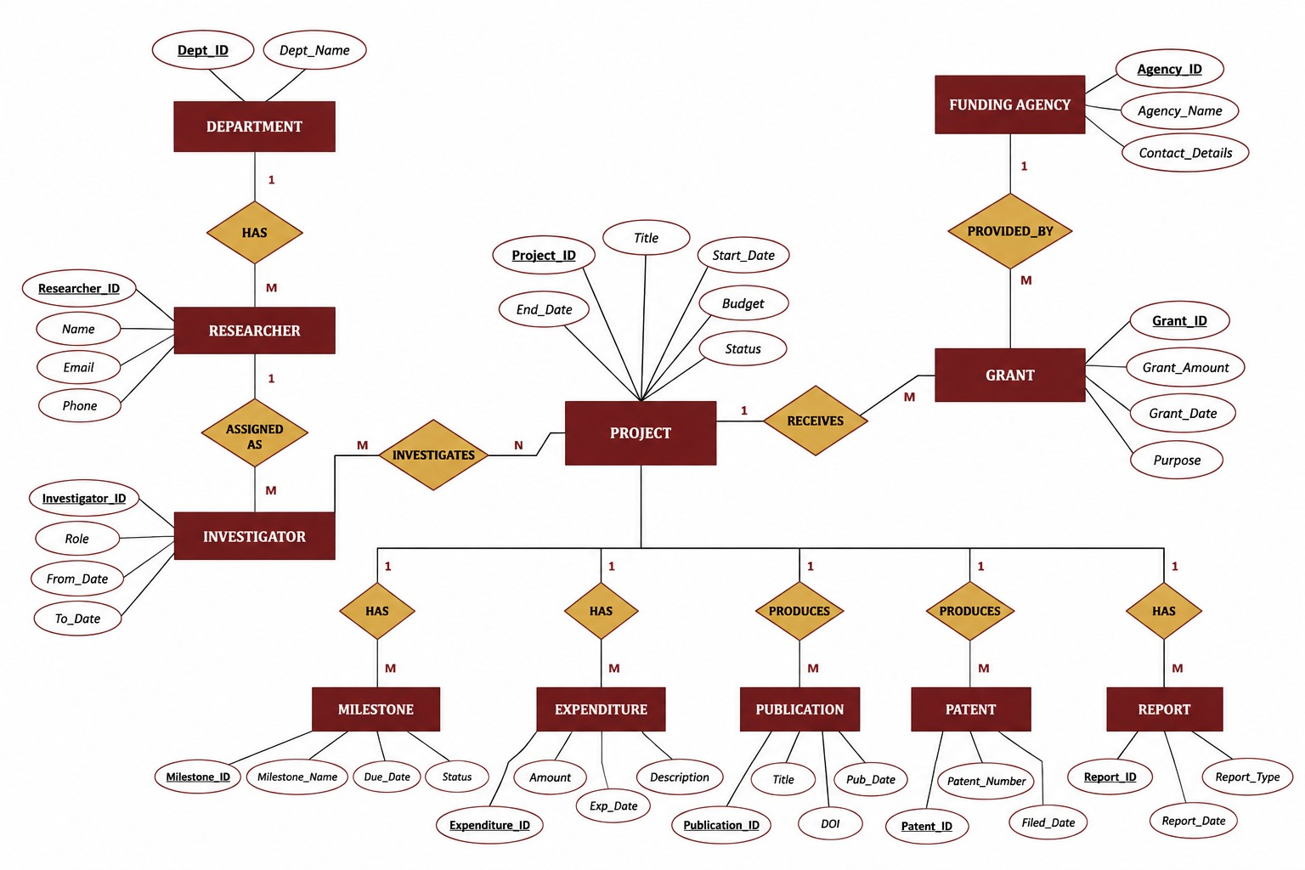
Conceptual ER Diagram

Slide 3
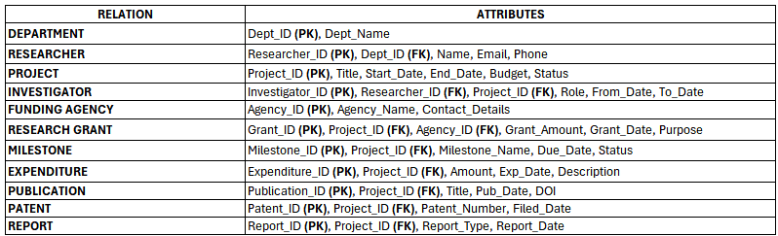
Relational Schema

Slide 4
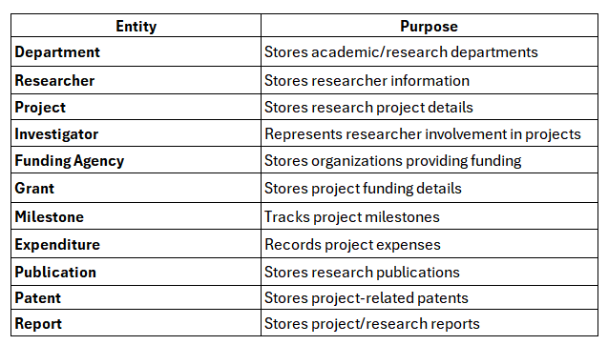

Main Entities

Slide 5
Thank You
(review 2)

